Slide 1
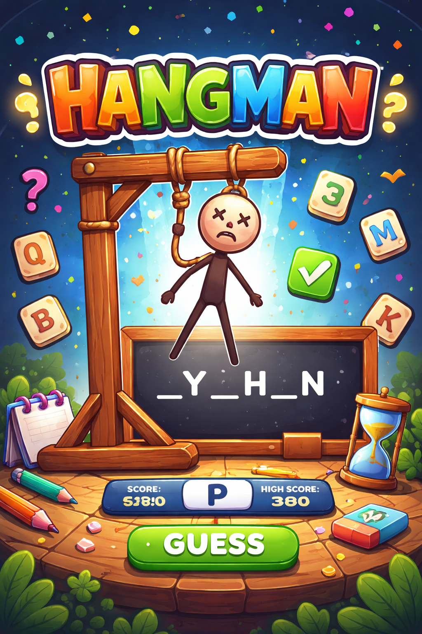
HANGMAN GAME
PYTHON PROJECT

Slide 2
Introduction
The Hangman Game is a classic and popular word-guessing game that tests a player’s vocabulary, logic, and problem-solving skills. In this game, the player attempts to guess a hidden word by suggesting one letter at a time. Each correct guess reveals the position of the letter in the word, while each incorrect guess brings the player closer to losing the game by completing a hangman figure.
1. This project is a graphical Hangman game developed using Python and Tkinter.
2 .The game challenges players to guess a hidden word letter by letter before the hangman figure is completed.
3 .It includes difficulty levels (Easy, Medium, Hard), sound effects, background music, and a scoring system.
4 .The application uses a modern dark-themed UI with animations and real-time feedback.

Slide 3
Technologies & Key Features
Technologies Used:
Python – Core programming language
Tkinter – GUI development
Requests – Fetching random words from an online API
Winsound & Threading – Sound effects and background music
OS Module – High score file handling

Slide 4
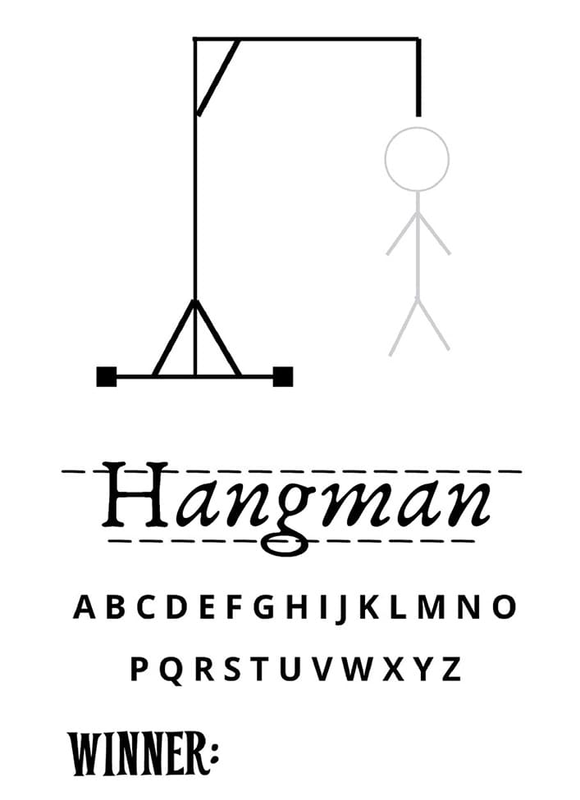
Key Features
✔ Difficulty Levels (Easy / Medium / Hard)
✔ Real-time letter guessing
✔ Animated hangman drawing
✔ Sound effects for correct & wrong guesses
✔ Background music toggle
✔ Score & High Score tracking
✔ Automatic word reveal on game over

Slide 5
How the Game Works:
Player selects a difficulty level and starts the game
A random word is generated based on difficulty
Player guesses letters using the input box
Correct guesses increase score and reveal letters
Wrong guesses draw hangman parts step-by-step
Game ends when:
  ✅ All letters are guessed (WIN)
  ❌ Hangman drawing is completed (GAME OVER)

Slide 6
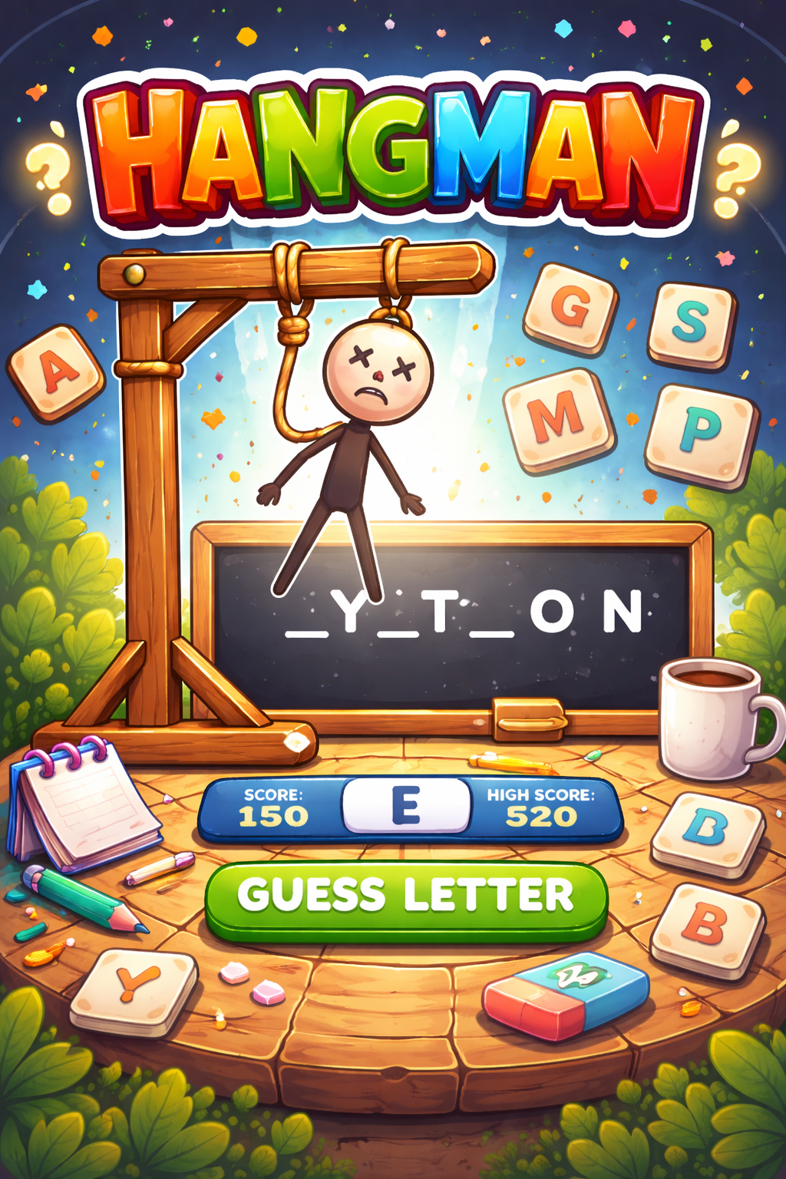
Conclusion:
1. This Hangman game successfully combines logic, UI design, and interactivity.
2. It improves understanding of event-driven programming and GUI-based applications.
3. The project can be further enhanced by adding themes, multiplayer mode, or hint systems.

